Slide 1

Stoneham Police Department Select Board Presentation January 7, 2025

Slide 2

FY2025 year in review
Four (4) officers and one (1) Civilian left the department; two (2) resignations, three (3) retirements
Hired seven (7) Police Officers; Five (5) New Recruits, One (1) Re-Hire (Academy Trained), One (1) Lateral Transfer (Academy Trained), One (1) Civilian DV Advocate appointed
One (1) officer was promoted to the rank of Sergeant
One (1) Detective assigned to FBI Organized Crime Drug Enforcement Task Force (OCDETF)
Stoneham PD participated in National Night Out in summer of 2024
Held our first SPD Movie Night on the Common
“Coffee with a Cop” events at Target
Participated in 2nd Annual Special Olympics Softball Game – Sandlot Spartans- 15 PD/FD/DPW- 0
Notes:
Out of the 7 hires. 4 were for resignation/retirement in FY25 and 3 are from prior fiscal year retirement/promotions that were not filled

Slide 3
FY2025 year in review Continued
Initiated department reorganization project – Created a new division within the organizational structure, Administrative Services Division. Also reorganized other positions within the department to ensure clear oversight and reporting guidelines. With the goal being, streamlining operations, optimize existing operations by clearly defining roles and responsibilities, create new roles where necessary, providing for better accountability and internal communication, leading to higher efficiency and service to the community
Enhanced and Revitalized the Police Background Investigation Process
Implementation of Body Worn Cameras (BWC), to include a new role of BWC Supervisor.

Slide 4
2024 Calls for service
Notes:
4% Increase in service calls from 2022 to 2023, 1.89% increase from 2023 to 2024, 5.82% increase from 2022-2024.

Slide 5
2024 FBI major Crimes
Notes:
FBI Classifies these as “Part 1” or Major Crimes that they define as the major crimes plaguing society in the US, Larceny included shoplifting (28).

Slide 6
2024 Statistics Continued

Slide 7
Drug Overdose/Mental Health Related Calls
Notes:
2024- OD’s 15 residents & 4 non-residents (Avg. age 45) OD deaths 2 residents & 1 non-resident (Avg. age 49)

Slide 8
Grant Funding
Through the work of the Department’s Grant Administrator, Lieutenant Chris Apalakis, the police department received the following grant funding:
$231K – State 9-1-1 Department – used for state mandated 9-1-1 related training; helping to offset overtime costs of police officers and dispatchers working as telecommunicators; and cost of Armstrong Ambulance providing required emergency medical dispatch services.
$155K – Department of Mental Health – used to fund the mental health clinician shared by Stoneham and Melrose; mental health training courses and overtime

Slide 9
Grant Funding CONTINUED
$36K – Executive Office of Public Safety and Security – used for traffic enforcement, bicycle and pedestrian safety enforcement during specified statewide mobilization events; child passenger safety seat installation; and bicycle safety events.
$9.4K - Executive Office Of Public Safety and Security to equip police vehicles with electronic citations. Grant monies cover printers, software, hardware, installation and 1 year warranty on all equipment.
$250K - Executive Office Of Public Safety and Security to establish a Department Body Worn Camera (BWC) Program. Grant monies cover all hardware, software, and storage, for five (5) years.

Slide 10
FY2026 Goals
Continue the hiring process for recruits filling existing Department vacancies (1) FY’24 and (1) FY’25.
Seeking funding for one (1) Deputy Police Chief, and one (1) Additional Civilian Dispatcher (mid-night shift).
Community | Population (2020) | Deputy Chief/XO | Captains | Lieutenants | Sergeants | Police Officers | Total Dept. Complement
Stoneham | 23,244 | 0 | 0 | 3 | 7 | 31 | 44 (budgeted)
Melrose | 29,817 | 0 | 0 | 4 | 10 | 35 | 50
Saugus | 28,619 | 1 | 0 | 8 | 9 | 50 | 68
Danvers | 28,087 | 1 | 2 | 3 | 8 | 33 | 47
Wakefield | 27,090 | 1 | 0 | 2 | 11 | 32 | 47
Winchester | 22,970 | 0 | 0 | 4 | 8 | 27 | 40
Reading | 25,518 | 1 | 0 | 4 | 8 | 32 | 46
Wilmington | 23,349 | 1 | 0 | 5 | 7 | 38 | 52
North Reading | 15,554 | 1 XO | 0 | 3 | 7 | 21 | 32
Notes:
Seek funding for the creation of a Department Deputy Chief (non-civil service/non-union). This position would create a defined chain of command structure and would prepare for future succession planning for the police department. The position would also allow for a non-union, command staff member, to oversee and conduct Internal Affairs investigations, oversee and coordinate with the newly created Police Officer Standards and Training Commission (POSTC) requirements, to be the department public information officer and to assist with public records requests and budget preparation. The Deputy Chief would also oversee the department's body worn camera (BWC) program (agreed upon in CBA), as well as overseeing building, police vehicle maintenance and oversee all division commanders.

Slide 11
FY2026 Goals Continued
Continue with modification and creation of Department policies and procedures based upon requirements of police reform legislation and the Peace Officer Standards and Training Commission.
Accelerate our initiative to be certified and accredited by the Massachusetts Police Accreditation Commission.
Continued police, fire, and school department collaboration on emergency preparedness and training.
Create and Fund a Citizen’s Police Academy.
Continue to increase online presence to include Facebook and Instagram (monthly stats)
Monitor the organizational structure and reorganization of department, make adjustments when/if necessary.
Notes:
Certification & Accreditation are self-initiated process that police agencies voluntarily strive to meet and maintain standards that have been established as best practices. This is done through directives, policy, and procedure and most importantly practice. Standards can be equipment, holding facility, evidence and property room related, among other things (invest. Checklist, backgrounds, audits). Cert. is 178 standards.

Slide 12
FY2026 Budget Requests
Seeking funding for one (1) Deputy Police Chief ($170K)
Seeking funding for one (1) Civilian Dispatcher ($52K)
Continue to increase overtime funding to mirror actual overtime expenditures
Increase in body armor account to purchase ballistic vests ($8.4K to $11.2K)
$166K for two (2) marked police vehicles
$30K for one (1) police motorcycle, $4K M/C related safety equipment
$10K for existing cruiser repairs (non-warranty items)
$12.5K for Police Evidence Room Audit
$10K for Community Policing Events (Citizen’s Police Academy)
$2K for Firearms Range Rental
$6.4K for Police Academy Tuition, $11K Recruit Officer’s Uniforms (FY’24 & FY’25) Vacancies
Notes:
For body armor, we have to purchase armor for 2 new officers, Approx. $1,200.00 per officer.

Slide 13
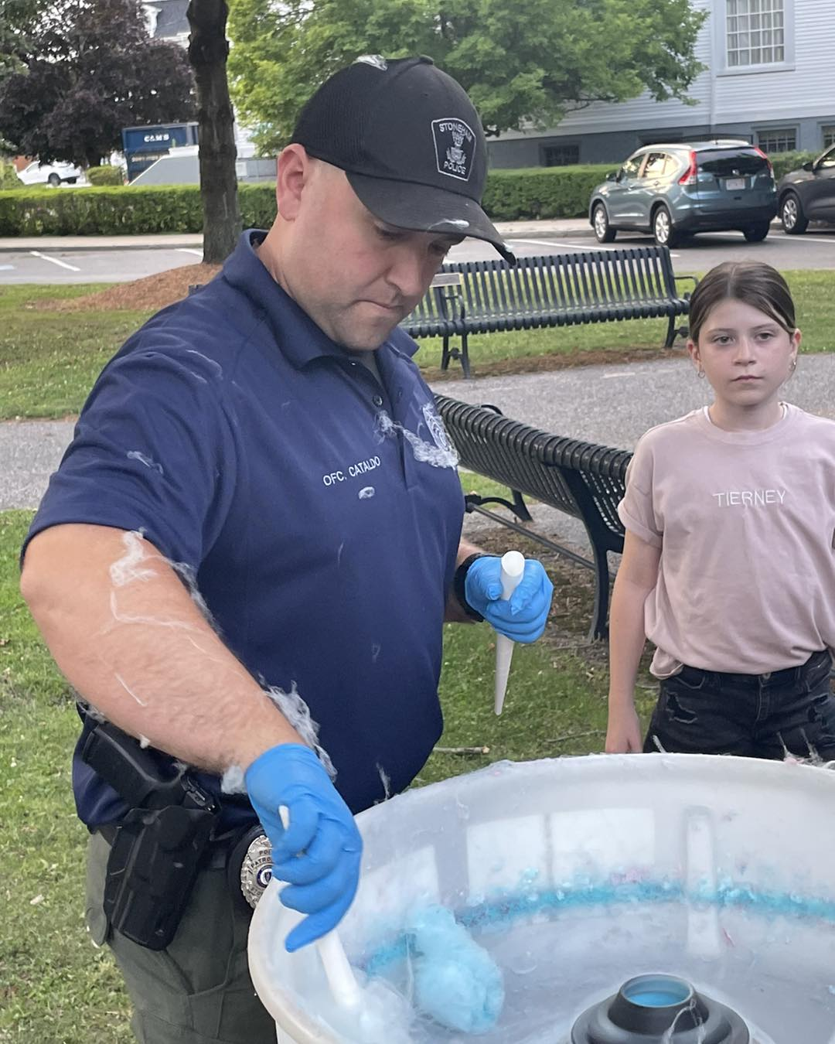

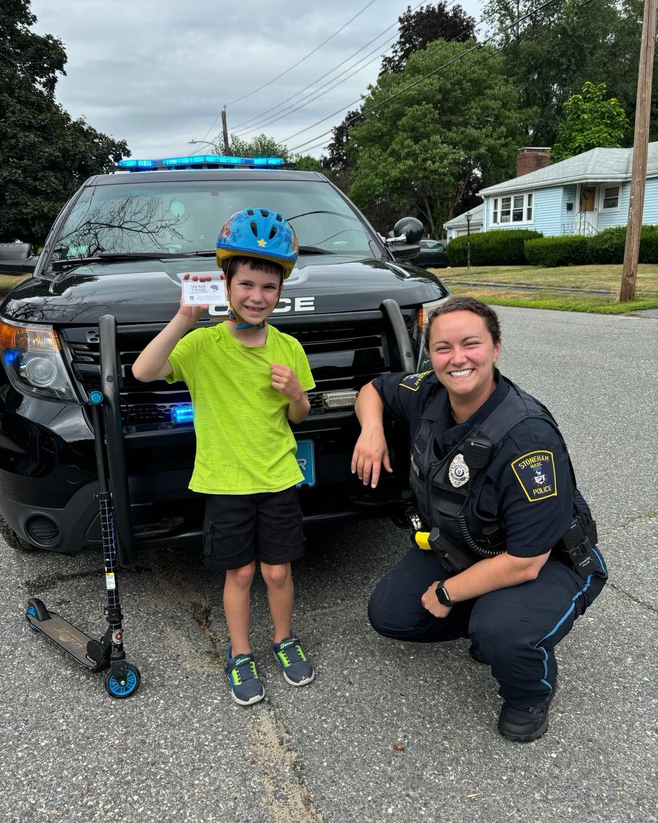
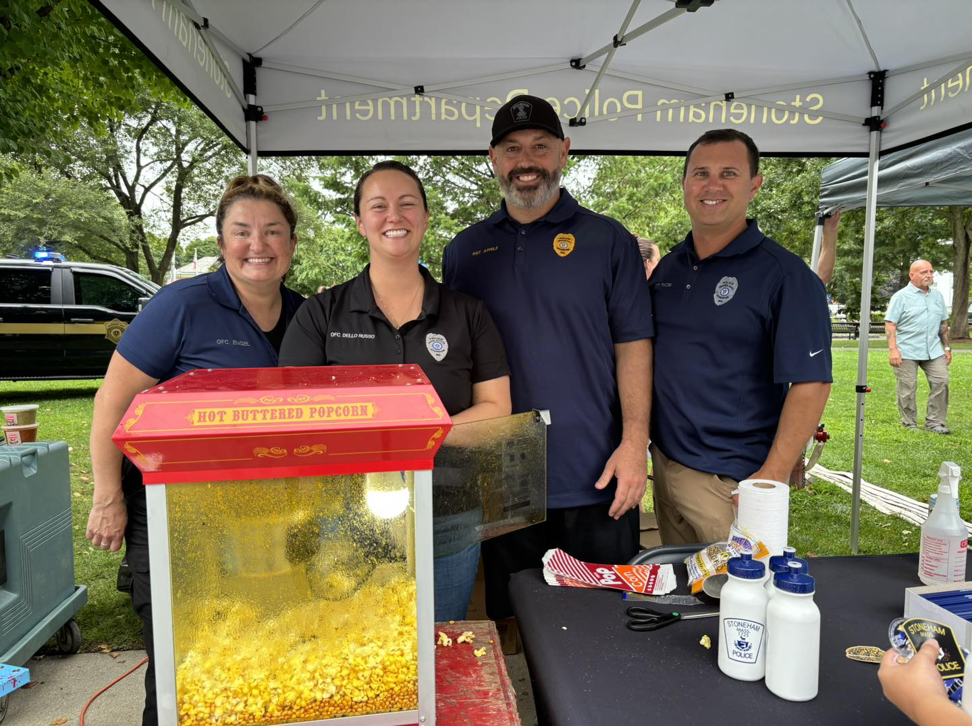
Notes:
These events have costs that are not funded in our OT and operating budgets.

Slide 14
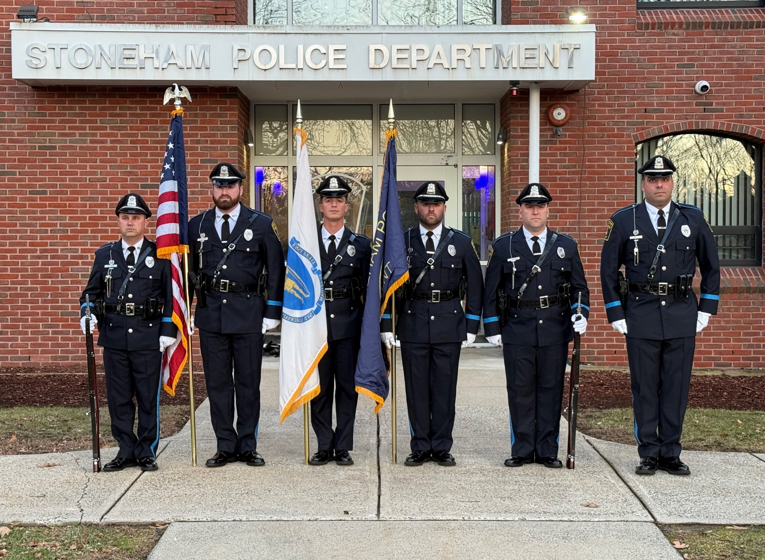
Notes:
Attended 9 events in 2024. 6k in OT cost

